Slide 1


Zomato Analytics
P536 (group-1)

Slide 2


Team Members
Sharad Nathwani
Venkatesh Gangji
Sakshi Suryawanshi
Aishwarya Singh
Dhanshree Wasankar
Ritika Singh
Reena Paunikar

Slide 3





Contents
Objectives
All Dashboards
MySQL Queries
Challenges
Conclusion

Slide 4
Objectives
The following analysis focuses on Zomato sales data, examining various aspects of restaurant operations and customer engagement. The dataset includes a comprehensive range of attributes that provide insights into the performance and characteristics of restaurants listed on Zomato across different countries. Here is an overview of the key data points used in the analysis
Restaurant ID: A unique identifier for each restaurant.
Restaurant Name: The name of the restaurant.
Country Code: A numeric code representing the country where the restaurant is located.
Country name: The name of the country where the restaurant operates.
City: The city in which the restaurant is situated.
Locality: The specific locality or neighborhood of the restaurant.
Price Bucket Range: The categorized range of prices.
Rating Range: The categorized range of ratings.
Rating Range Status: The status associated with the rating range.
This dataset allows for a detailed exploration of various factors that influence restaurant performance, customer preferences, and market trends within the Zomato platform. By analyzing these attributes, we can uncover patterns and insights that help understand the dynamics of the food and beverage industry across different regions and time periods

Slide 5




Tools Used
Excel:
Utilized for initial data exploration, cleaning, and basic analysis. Excel charts and pivot tables were created to visualize KPIs.
Tableau:
Employed for creating interactive and visually appealing dashboards. Various charts, including bar charts, funnel charts, and maps, were utilized to present KPIs effectively.
MySQL:
Executed for data manipulation, filtering, and aggregation to derive key metrics. SQL queries
were essential for preparing datasets for visualization.
Power B I
Utilized for creating dynamic and interactive dashboards. Power B I allowed for seamless integration of multiple data sources and the creation of visually appealing reports.

Slide 6
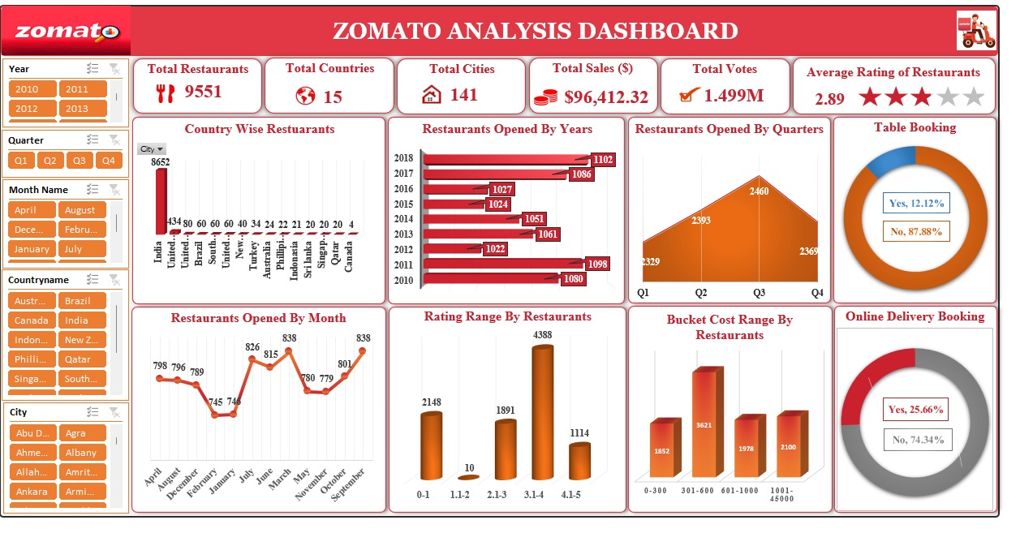
Excel Dashboard

Slide 7
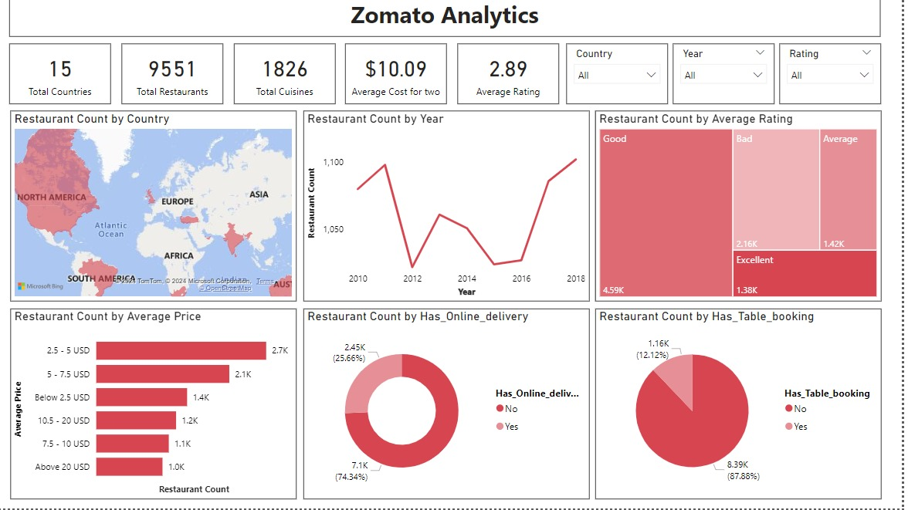
Power BI Dashboard

Slide 8
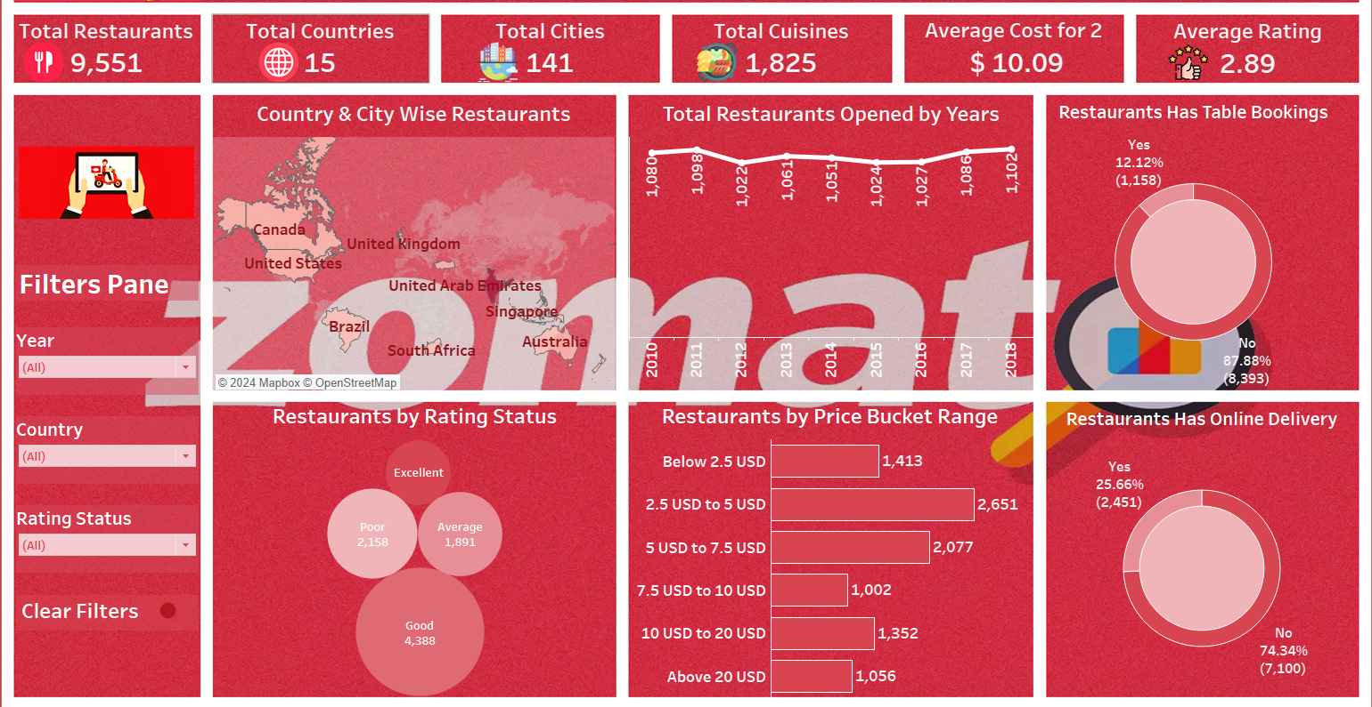
Tableau Dashboard

Slide 9
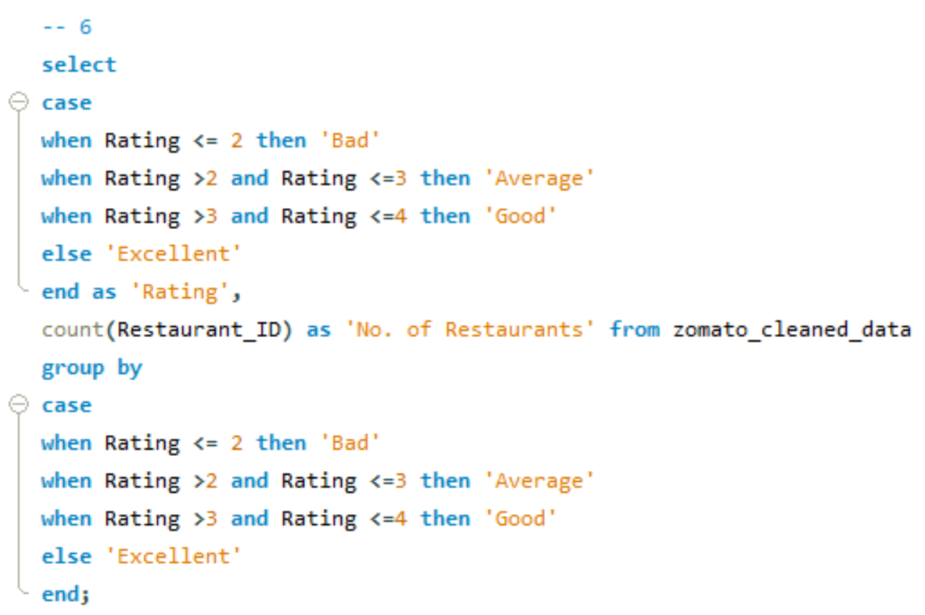
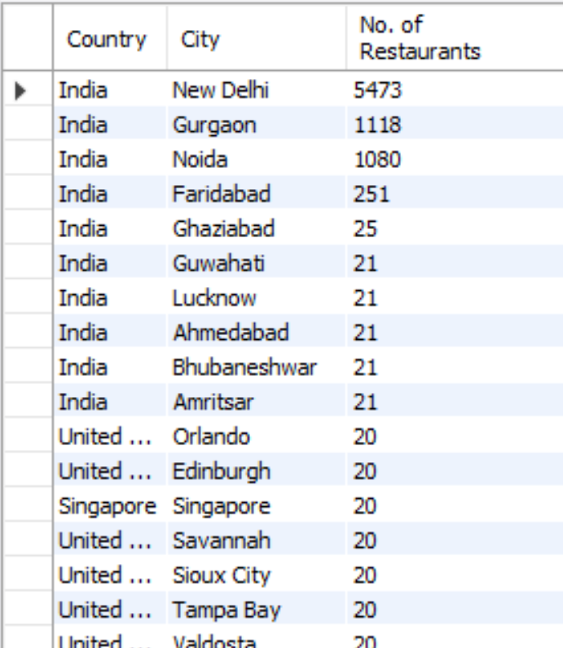
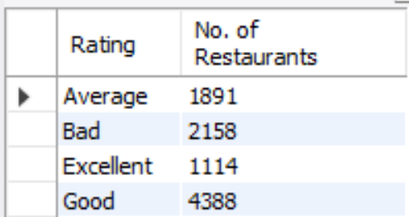
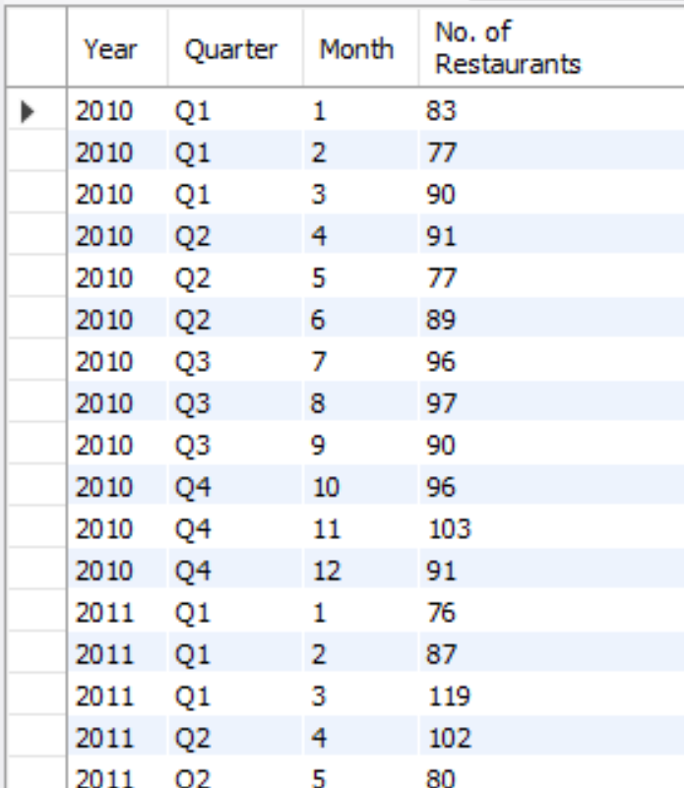
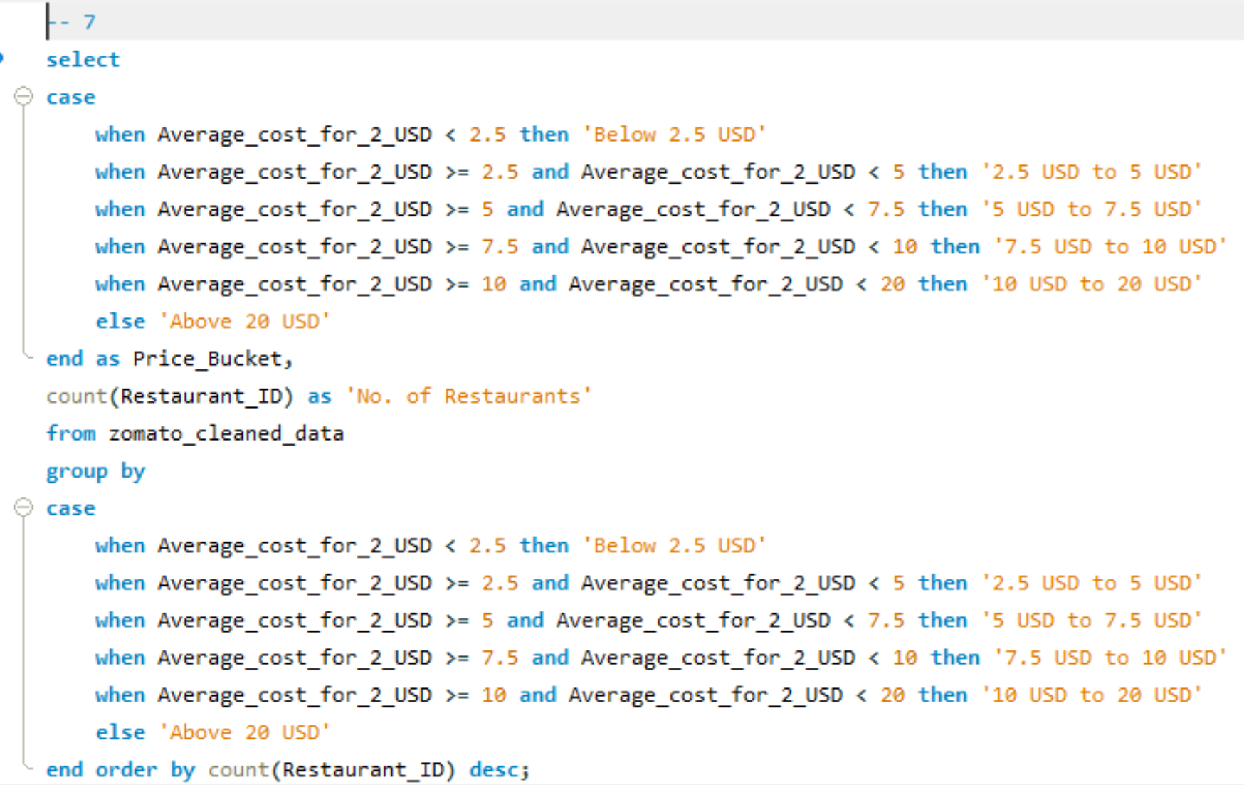
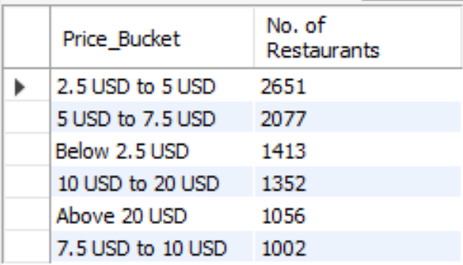
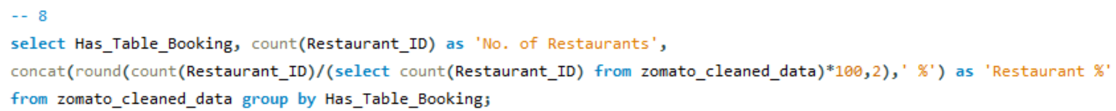
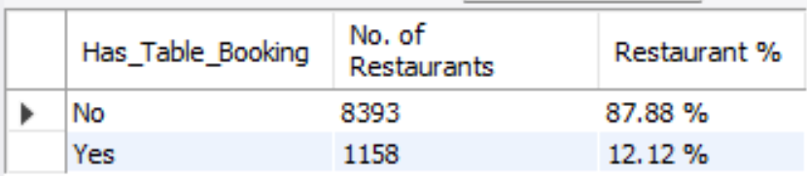
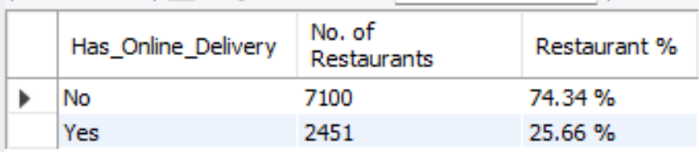
My SQL Queries

Slide 10
Challenges
Challenge - Data cleaning : Limited data entries showing up in MySQL, resulting in missing data. Like only 807 entries were being loaded in MySQL instead of 9551 entries. Possible Solution: Got rid off unnecessary Columns & Data like latitude, longitude, address, special characters & letters, etc. to load the dataset with all records in MySQL, in order to run the queries correctly.
Challenge - Selecting visuals: Difficulty in choosing the correct visual representation for displaying data related to multiple cities as there were 141 Cities. Possible Solution: So we used Map Visual to View the No. of Restaurants by Cities in Order to Display the Data Labels in a proper way.
Challenge – Tableau Drilldown : Lack of a drill-down option in Tableau for drilling down the KPI No. of Restaurants Values Opened by Year, Quarter & Month. Possible Solution: First we created 3 Line Charts i.e. Yearly Restaurants Opened, Quarterly Restaurants Opened & Monthly Restaurants Opened. Then we used Show/Hide Buttons to Include all three Charts at Same Place on Dashboard to View the Restaurants Opened Yearly, Quarterly & Monthly through this button feature.
Challenge - Data labels Visibility Data Labels were not clearly visible in the dashboard. Possible Solution: We adjusted the visualization size and font size according to the number of labels in each visual to improve clarity.

Slide 11
Conclusion
Top 4 selected countries for our expansion are Australia, Canada, Singapore and Sri Lanka. Our major focus will be on Australia, as this country has 3 most suitable cities.
According to our data, to get a higher rating, we must keep the rate of cuisines in the middle range, keep high quality cuisines and provide additional facilities in our new restaurants.
We must offer services like online delivery and table booking in more number of listed restaurants in order to increase the customer’s ratings because customers enjoy additional ease and convivence in their dining experience.
Approximately, 4388 restaurants has good ratings as compared to 2158 restaurants with the poor ratings. The operational efficiency can directly impact the ratings of the restaurants. For instance, high customer satisfaction ratings are linked to prompt delivery, order accuracy, and quality of food.
It came to our observation that the number of restaurants opening in a particular country is inversely proportional to the strictness in the food safety laws in that particular country. So in order to rapidly expand in the multiple nation we must co-ordinate with the government officials.

Slide 12
Thank you

